Slide 1
Learning with Large Datasets

Slide 2
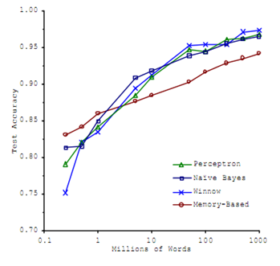
Machine learning and data
Classify between confusable words.
E.g., {to, two, too}, {then, than}.
For breakfast I ate _____ eggs.
Accuracy
Training set size (millions)
“It’s not who has the best algorithm that wins.
It’s who has the most data.”
[Figure from Banko and Brill, 2001]

Slide 3
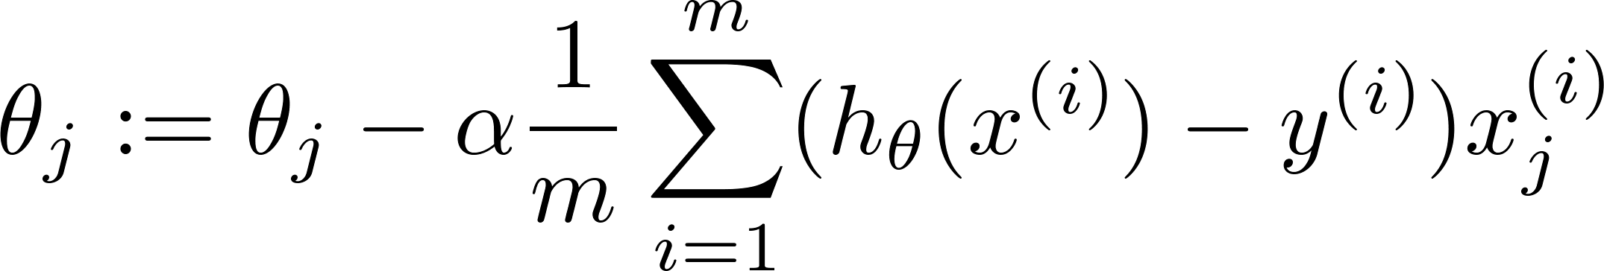
Learning with large datasets
Adding extra features, hidden unit in neural networks, .. (say) and then increasing m
Increasing m will not give us any gain
error
error
(training set size)
(training set size)
m = 1000

Slide 4
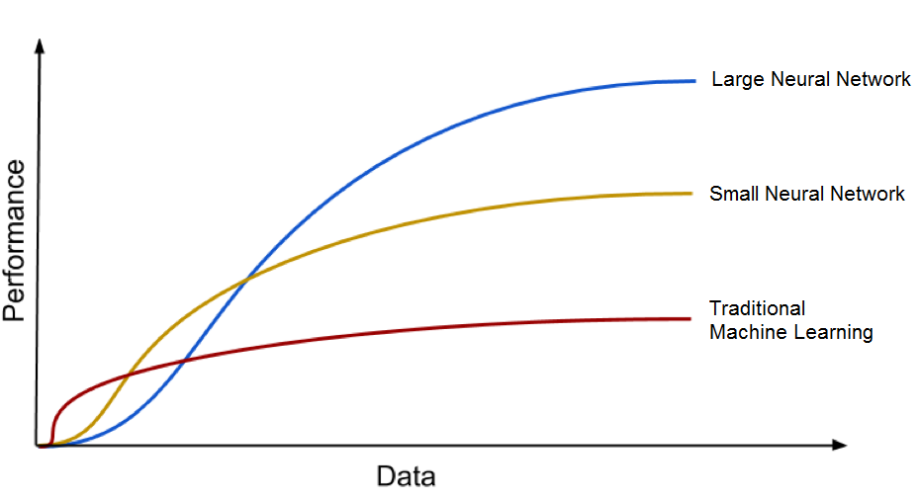

Slide 5
Stochastic Gradient Descent

Slide 6
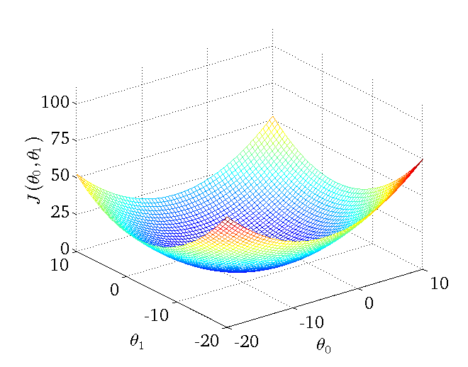
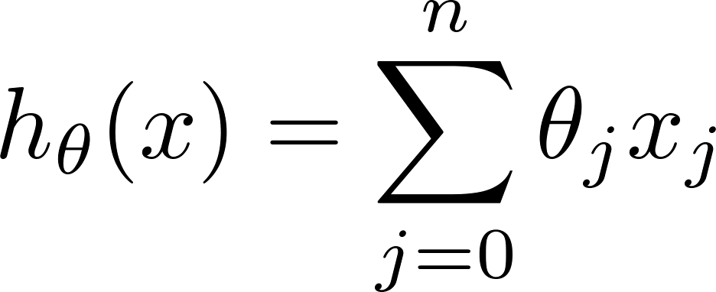
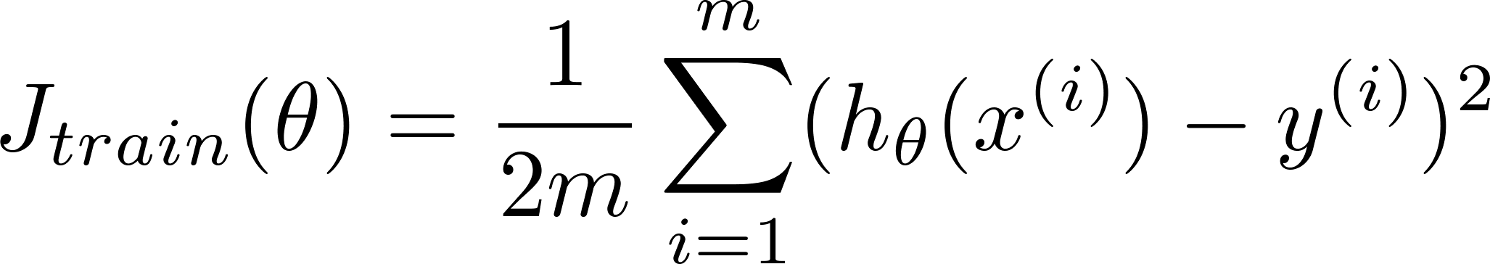
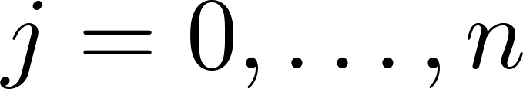
Linear regression with gradient descent
Repeat {
(for every )
}
Notes:
Add dots

Slide 7
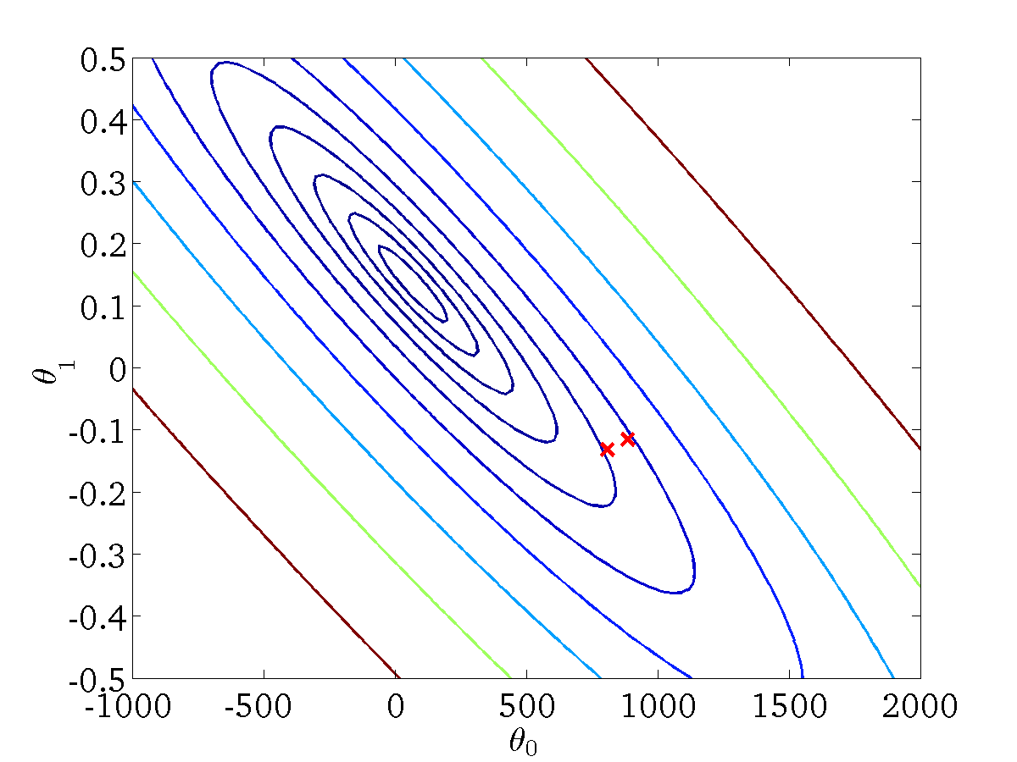
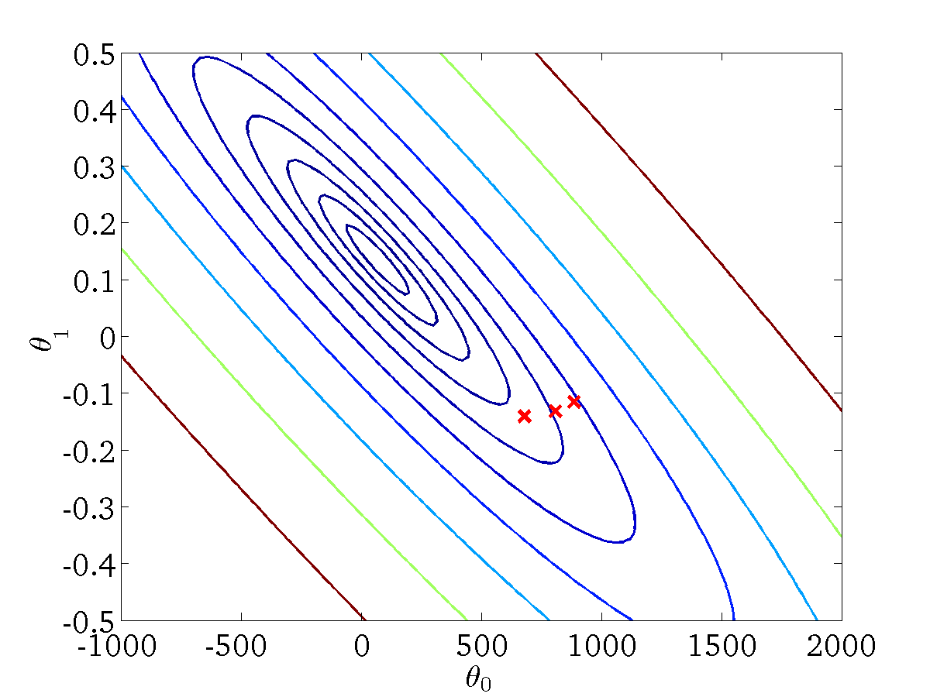

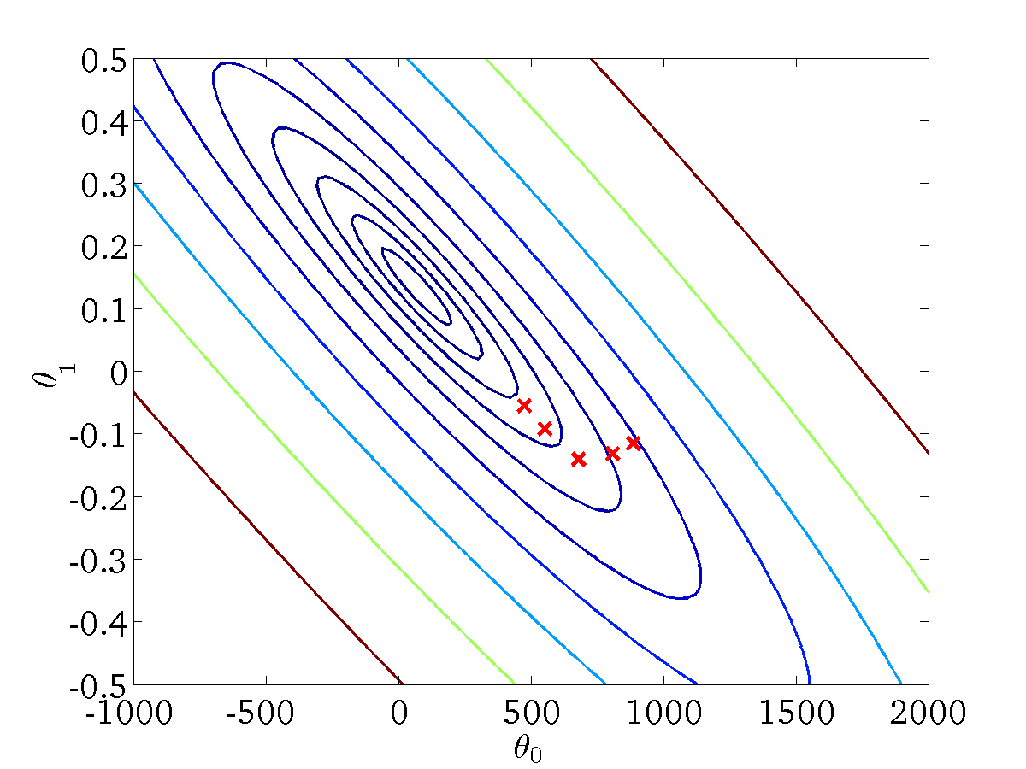


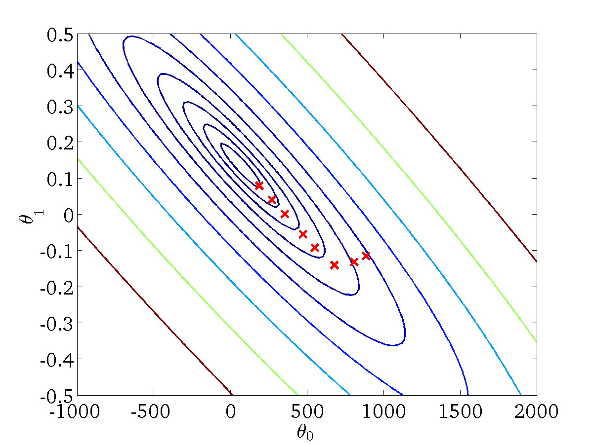


Linear regression with gradient descent
Repeat {
(for every )
}
When m is large then computing the
derivative becomes very difficult

Slide 8
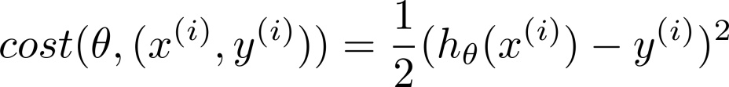
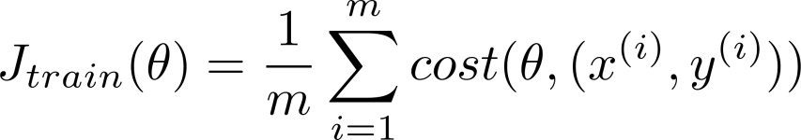
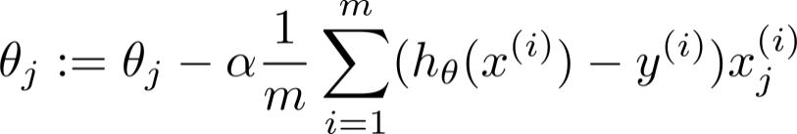

Batch gradient descent
Stochastic gradient descent
Repeat {
(for every )
}
(Pre-processing step)
step 1: we modify parameters and try to fit 1st training example.
step 1: we modify parameters and try to fit 2nd training example.
So on

Slide 9
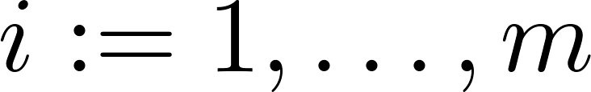
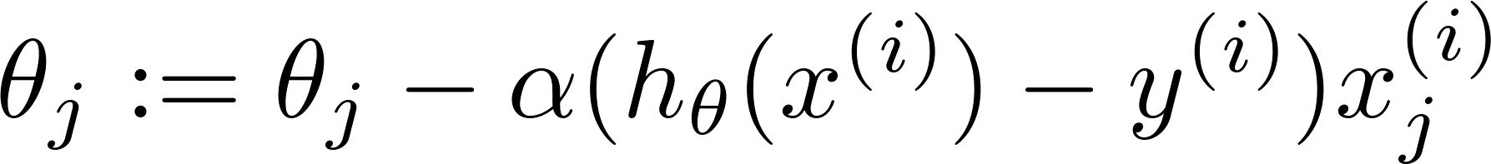
Stochastic gradient descent
Randomly shuffle (reorder) training examples
Repeat {
for {
(for every )
}
}
How much to repeat the for loop ?
Generally depends on the size of the training set but normally 1-10 repetition works fine

